Slide 1
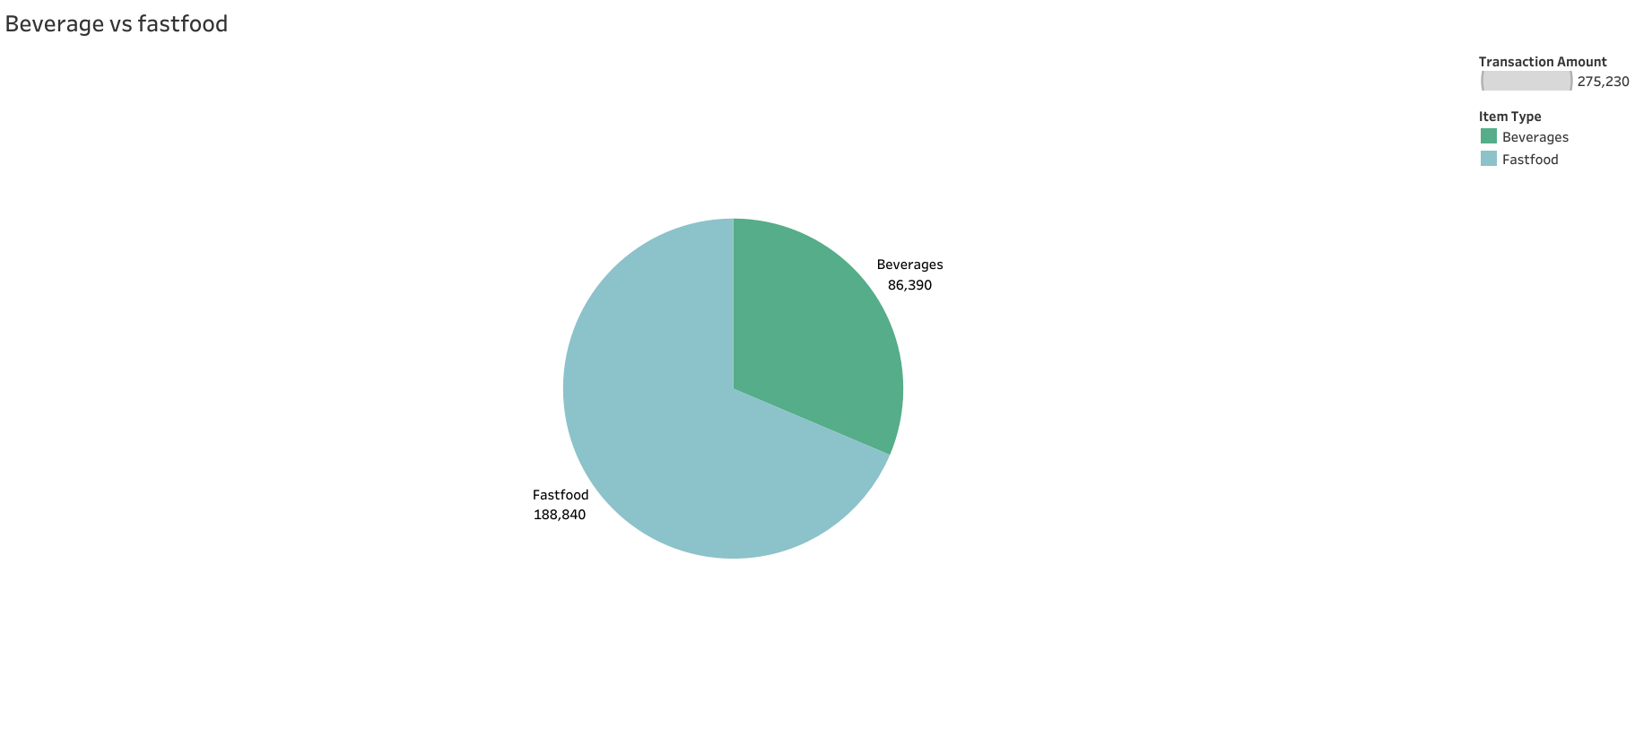
Fastfood has more than double the sales as compared to beverages as it has more varieties.

Slide 2
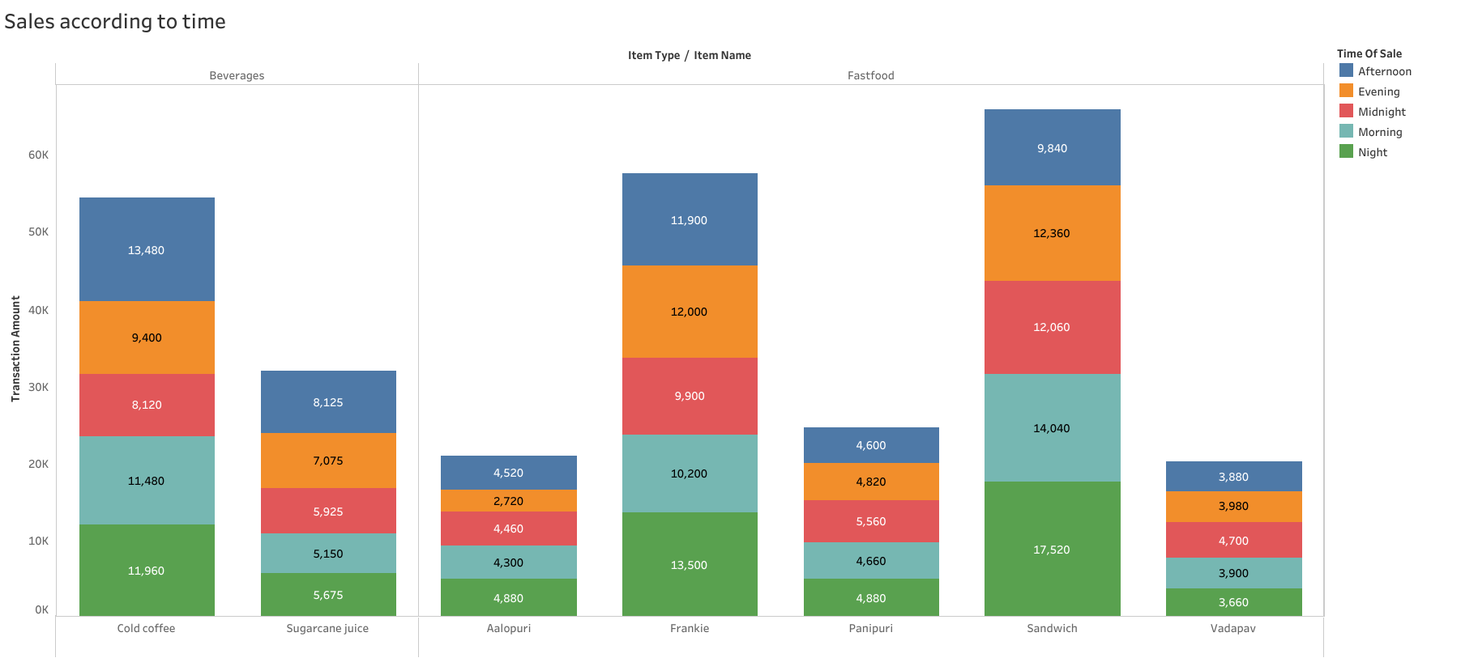
Irrespective of the time , frankie and sandwich are doing well in fastfood category also cold coffee in the beverage category.

Slide 3
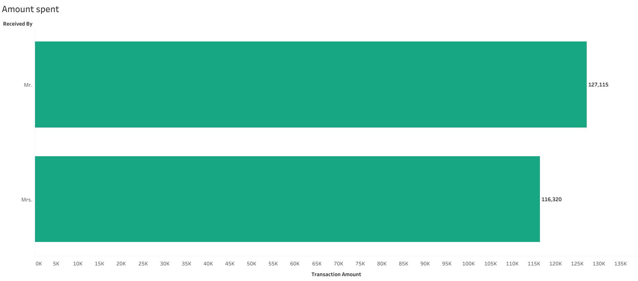
With respective to the data, most customers were male .

Slide 4
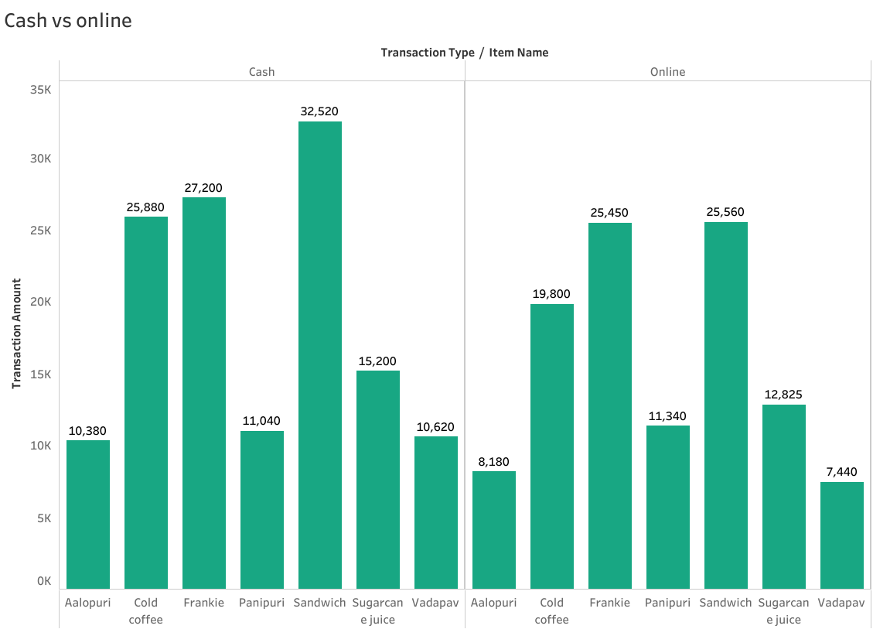
Cash is the most preferred mode of payment.

Slide 5
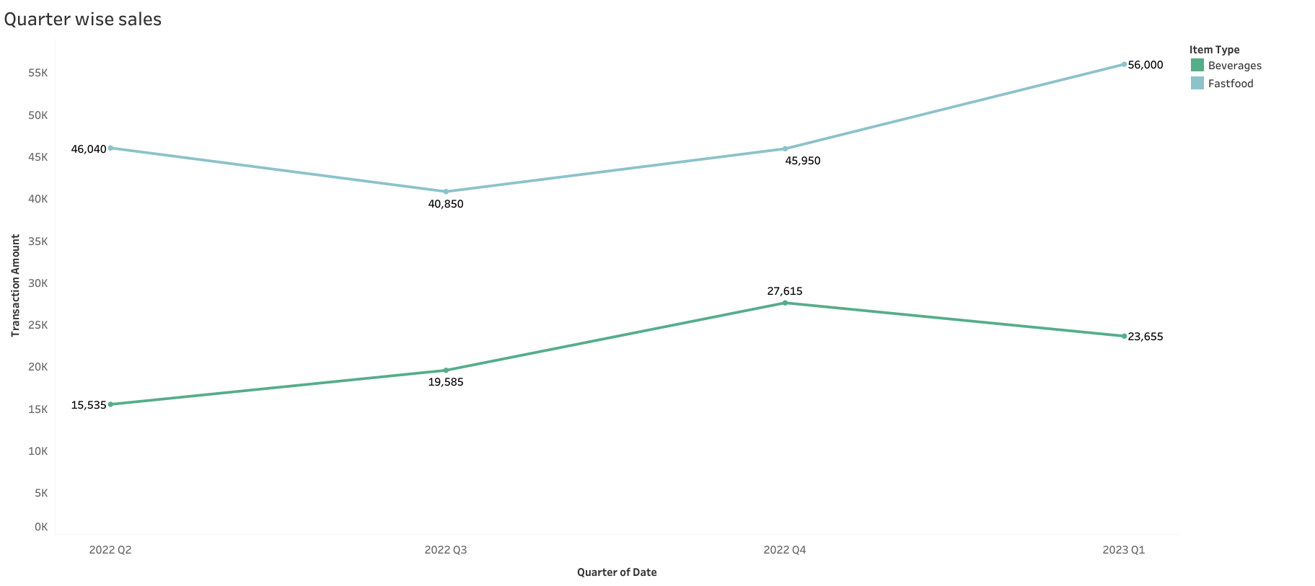
In 2022, fastfood did well in the 2nd quarter and beverages did well in the last quarter, and in the 1st quarter of 2023, again fastfood category performed well.

